Slide 1
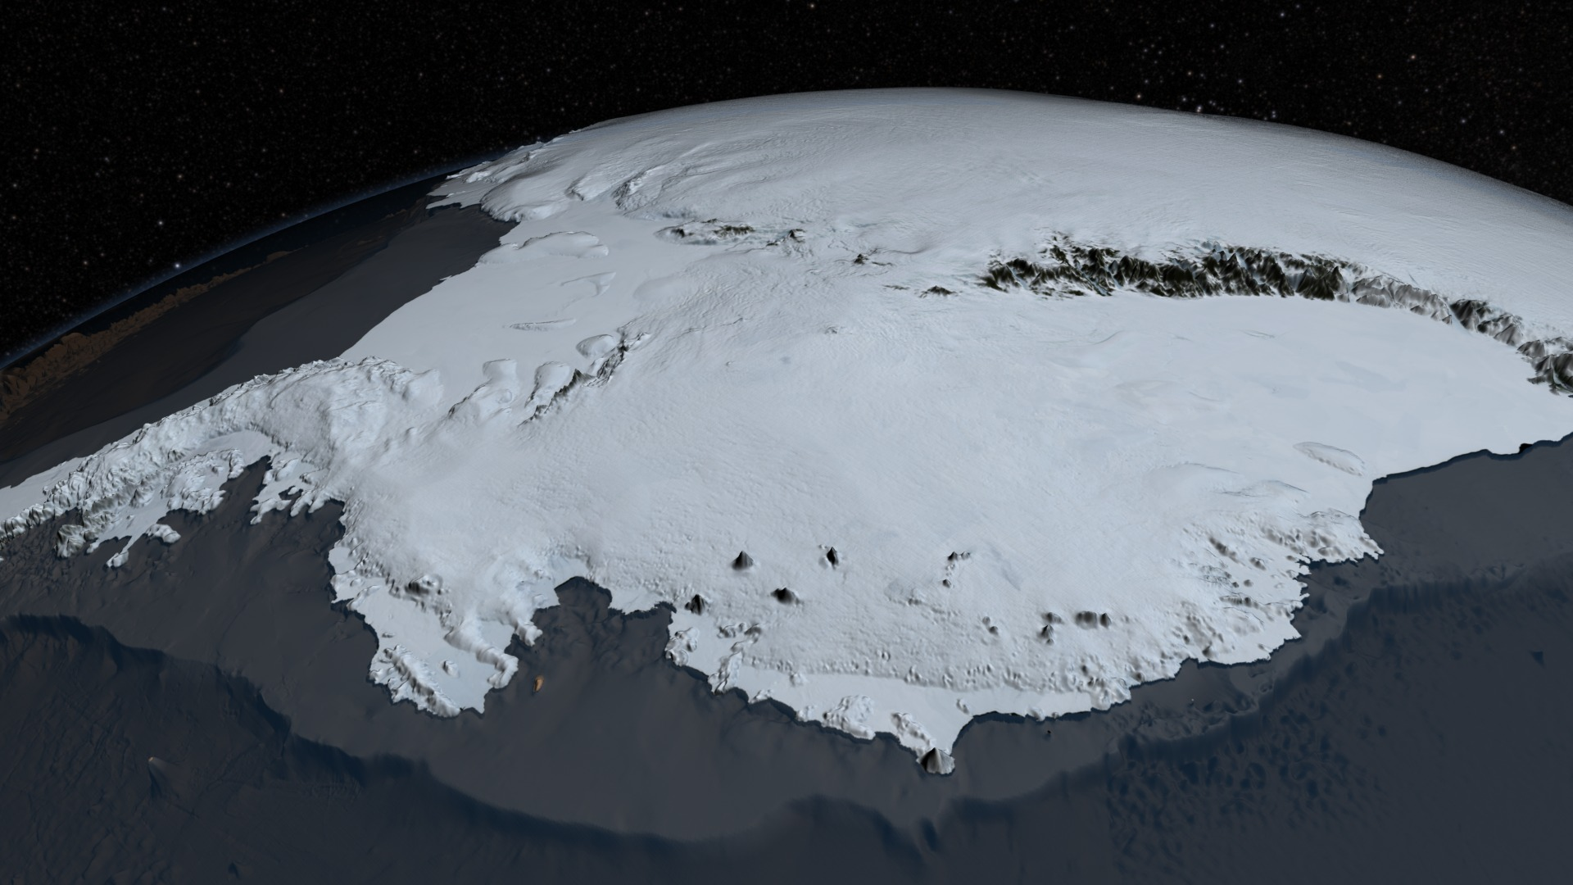

Polar Ice melt and Sea Level Rise
Antarctic Ice Sheet (Visualization from NASA's mission Operation IceBridge dataset BEDMAP2)
By Lea Fortmann and Penny Rowe with funding from the National Science Foundation.
Notes:
Image from https://en.wikipedia.org/wiki/Antarctic_ice_sheet#/media/File:AA_bedrock_surface.4960.tif

Slide 2
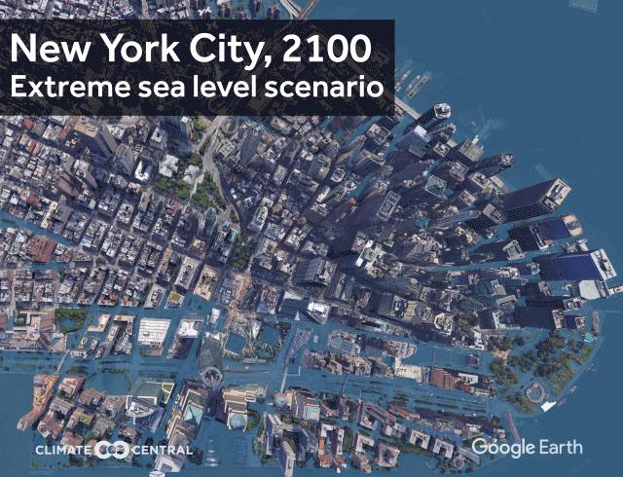
Learning Objectives and Module Overview
In this module you will explore:
Why is sea level rising and how are polar regions contributing?
What is storm surge and how will it affect Tacoma?
How should we prepare?
From Climate Central
(https://www.climatecentral.org/outreach/alert-archive/2017/2017SeaLevelCM-TVM.html)

Slide 3
Learning Objectives and Module Overview
In this module you will explore:
Why is sea level rising and how are polar regions contributing?
What is storm surge and how will it affect Tacoma?
How should we prepare?
From Climate Central
(https://www.climatecentral.org/outreach/alert-archive/2017/2017SeaLevelCM-TVM.html)

Slide 4
Learning Objectives and Module Overview
Learning Objectives:
Economics about risk and uncertainty and how to:
Gather data on home property values and flood probabilities.
Apply them to a decision-making framework using economic modeling.
Learn about marginal damage curves.
Estimate the damage costs of sea level rise and flooding in your region.
Formulate a policy recommendation for how best to adapt to climate change and sea level rise in your region.
Increase climate literacy by connecting sea level rise due to ice melt in the polar regions to the local flood levels.
Gain computational skills through calculating and graphing in Microsoft Excel.

Slide 5
Introduction: Why is Sea Level Rising?
Sea level is rising primarily due to causes:
As ocean water warms, it expands, so the oceans are taking up more volume.
Polar ice is melting.

Slide 6
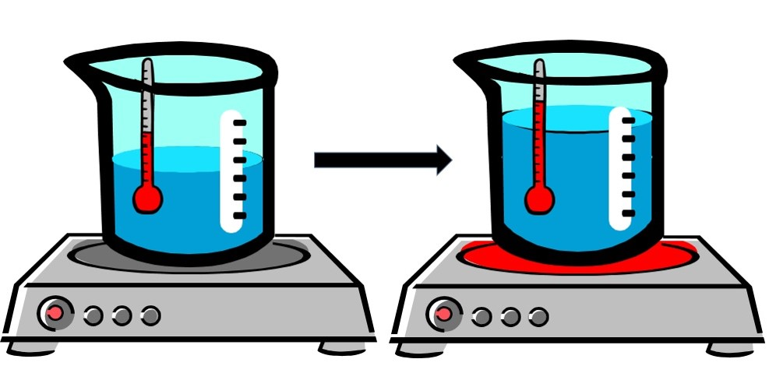
Introduction: Why is Sea Level Rising?
Expanding ocean water takes up a greater volume
When water warms, the molecules move faster, and it expands.

Slide 7
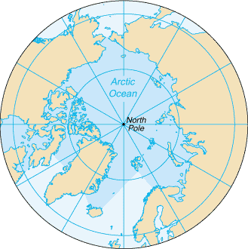
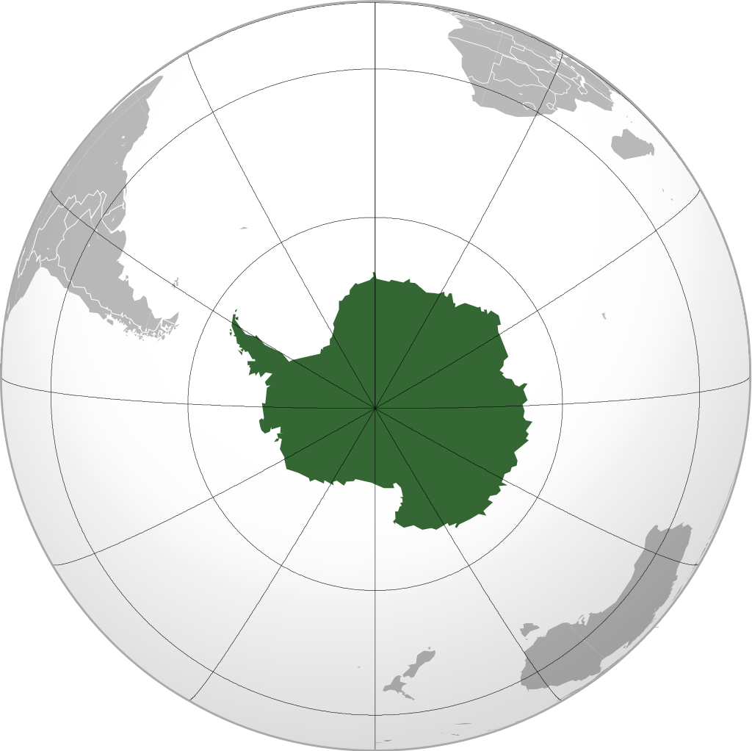
Introduction: Why is Sea Level Rising?
Polar Ice is melting
North Pole
South Pole
Notes:
Antarctica: By Heraldry - Own work,The map has been created with the Generic Mapping Tools: http://gmt.soest.hawaii.edu/ using one or more of these public-domain datasets for the relief:ETOPO2 (topography/bathymetry): http://www.ngdc.noaa.gov/mgg/global/global.htmlGLOBE (topography): http://www.ngdc.noaa.gov/mgg/topo/gltiles.htmlSRTM (topography): http://www2.jpl.nasa.gov/srtm/বাংলা | English | français | italiano | 日本語 | македонски | sicilianu | +/−Permission is granted to copy, distribute and/or modify this document under the terms of the GNU Free Documentation License, Version 1.2 or any later version published by the Free Software Foundation; with no Invariant Sections, no Front-Cover Texts, and no Back-Cover Texts. A copy of the license is included in the section entitled GNU Free Documentation License., CC BY-SA 3.0, https://commons.wikimedia.org/w/index.php?curid=7275830

Slide 8
Introduction: Why is Sea Level Rising?
Polar Ice is melting
Africa
Alaska
South America
Greenland
Australia
North Pole
Arctic
Polar bears
South Pole
Antarctic
Penguins
Notes:
Antarctica: By Heraldry - Own work,The map has been created with the Generic Mapping Tools: http://gmt.soest.hawaii.edu/ using one or more of these public-domain datasets for the relief:ETOPO2 (topography/bathymetry): http://www.ngdc.noaa.gov/mgg/global/global.htmlGLOBE (topography): http://www.ngdc.noaa.gov/mgg/topo/gltiles.htmlSRTM (topography): http://www2.jpl.nasa.gov/srtm/বাংলা | English | français | italiano | 日本語 | македонски | sicilianu | +/−Permission is granted to copy, distribute and/or modify this document under the terms of the GNU Free Documentation License, Version 1.2 or any later version published by the Free Software Foundation; with no Invariant Sections, no Front-Cover Texts, and no Back-Cover Texts. A copy of the license is included in the section entitled GNU Free Documentation License., CC BY-SA 3.0, https://commons.wikimedia.org/w/index.php?curid=7275830

Slide 9
Introduction: Why is Sea Level Rising?
Polar Ice is melting
Greenland
Notes:
Antarctica: By Heraldry - Own work,The map has been created with the Generic Mapping Tools: http://gmt.soest.hawaii.edu/ using one or more of these public-domain datasets for the relief:ETOPO2 (topography/bathymetry): http://www.ngdc.noaa.gov/mgg/global/global.htmlGLOBE (topography): http://www.ngdc.noaa.gov/mgg/topo/gltiles.htmlSRTM (topography): http://www2.jpl.nasa.gov/srtm/বাংলা | English | français | italiano | 日本語 | македонски | sicilianu | +/−Permission is granted to copy, distribute and/or modify this document under the terms of the GNU Free Documentation License, Version 1.2 or any later version published by the Free Software Foundation; with no Invariant Sections, no Front-Cover Texts, and no Back-Cover Texts. A copy of the license is included in the section entitled GNU Free Documentation License., CC BY-SA 3.0, https://commons.wikimedia.org/w/index.php?curid=7275830

Slide 10
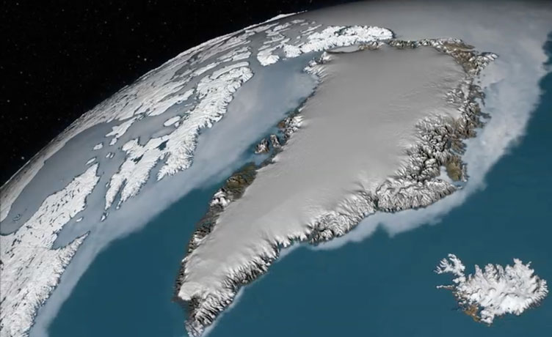
Introduction: Greenland Melt
The Greenland ice sheet is melting.
Contributes 20% of sea level rise
Could raise sea level 6 feet by 2100.
Would displace 187 million people.
Greenland Ice Sheet (Image from NASA’s scientific visualization studio)

Slide 11
Introduction: Why is Sea Level Rising?
Polar Ice is melting
Antarctica
Notes:
Antarctica: By Heraldry - Own work,The map has been created with the Generic Mapping Tools: http://gmt.soest.hawaii.edu/ using one or more of these public-domain datasets for the relief:ETOPO2 (topography/bathymetry): http://www.ngdc.noaa.gov/mgg/global/global.htmlGLOBE (topography): http://www.ngdc.noaa.gov/mgg/topo/gltiles.htmlSRTM (topography): http://www2.jpl.nasa.gov/srtm/বাংলা | English | français | italiano | 日本語 | македонски | sicilianu | +/−Permission is granted to copy, distribute and/or modify this document under the terms of the GNU Free Documentation License, Version 1.2 or any later version published by the Free Software Foundation; with no Invariant Sections, no Front-Cover Texts, and no Back-Cover Texts. A copy of the license is included in the section entitled GNU Free Documentation License., CC BY-SA 3.0, https://commons.wikimedia.org/w/index.php?curid=7275830

Slide 12
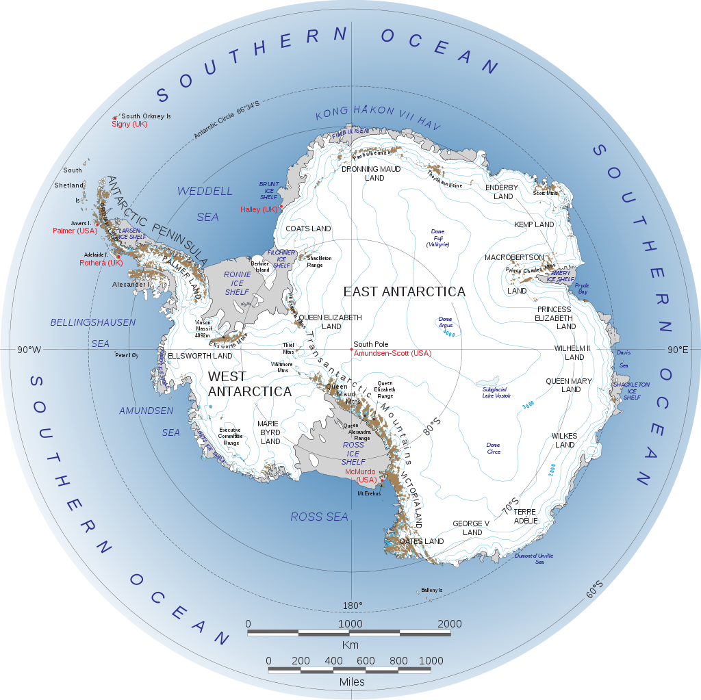
Introduction: Antarctic Ice Melt
In West Antarctica, glaciers are melting into the sea.
Could raise sea level >3 feet by 2100.
Irreversible.
Image from NASA, by Landsat Image Mosaic of Antarctica team

Slide 13
Introduction: Antarctic Ice Melt
In West Antarctica, glaciers are melting into the sea.
Could raise sea level >3 feet by 2100.
Irreversible.
Image from NASA, by Landsat Image Mosaic of Antarctica team

Slide 14
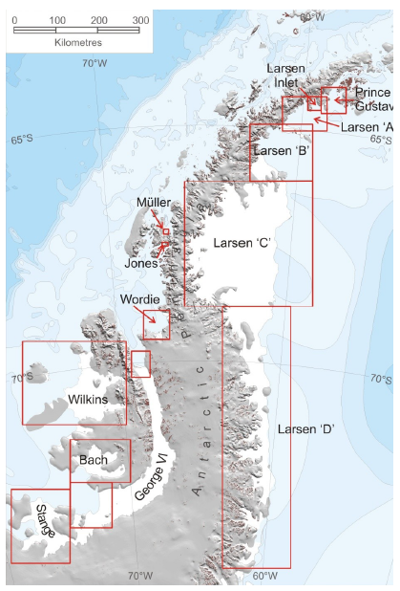
Introduction: Antarctic Ice Melt
Image by A. J. Cook and D. G. Vaughan (creative commons; https://commons.wikimedia.org/wiki/File:Antarctic-Peninsula-Ice-Shelves.png)
Image from NASA, by Landsat Image Mosaic of Antarctica team

Slide 15
Introduction: Antarctic Ice Melt
Video: https://www.theguardian.com/world/video/2017/jul/12/vast-iceberg-splits-from-antarctic-ice-shelf-video-explainer (<2 minutes)
Video
https://video.nationalgeographic.com/video/magazine/0000015c-d022-d1cb-a7fd-d4ffc11f0000 (4 minutes)

Slide 16
Pause for Analysis: Polar Ice Melt
What are the two main causes of sea level rise?
How does sea ice melt contribute to sea level rise?
Besides loss of ice shelves, what else do you think might be contributing to melting ice?

Slide 17
Homework
While changes in sea levels are expected to be relatively gradual, taking place over hundreds of years, there is much uncertainty in the timing and extent of future sea level rise. Ultimately, it will depend on how fast ice melts in the polar regions, including the Arctic in the north and Antarctic in the south. Cities need to start preparing for these coming changes now. However, trying to determine the best course of action from a policy and urban planning perspective is challenging.
Read this article from the Scientific American and be prepared to discuss it next time:
How is World Sea Level Rise Driven by Melting Arctic Ice?
The Larsen Ice Shelf is situated along the northeastern coast of the Antarctic Peninsula, one of the fastest-warming places on the planet. Image Credit: NASA Earth Observatory image by Jesse Allen, using Landsat data from the U.S. Geological Survey.
Notes:
National Geographic video link: https://video.nationalgeographic.com/video/magazine/0000015c-d022-d1cb-a7fd-d4ffc11f0000
Scientific American article: https://www.scientificamerican.com/article/how-is-worldwide-sea-level-rise-driven-by-melting-arctic-ice/

